Slide 1
Knowing your learner

Slide 2
What is my job as a teacher?

Slide 3
Why do we need to know the learner?

Slide 4
50% learners vs 10% faculty
Concrete Active

Slide 5
How can we learn more?

Slide 6
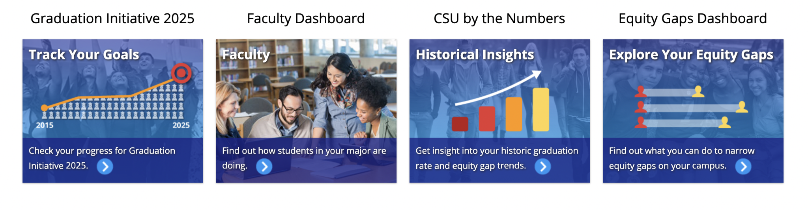
https://csusuccess.dashboards.calstate.edu/public/dashboard-index

Slide 7
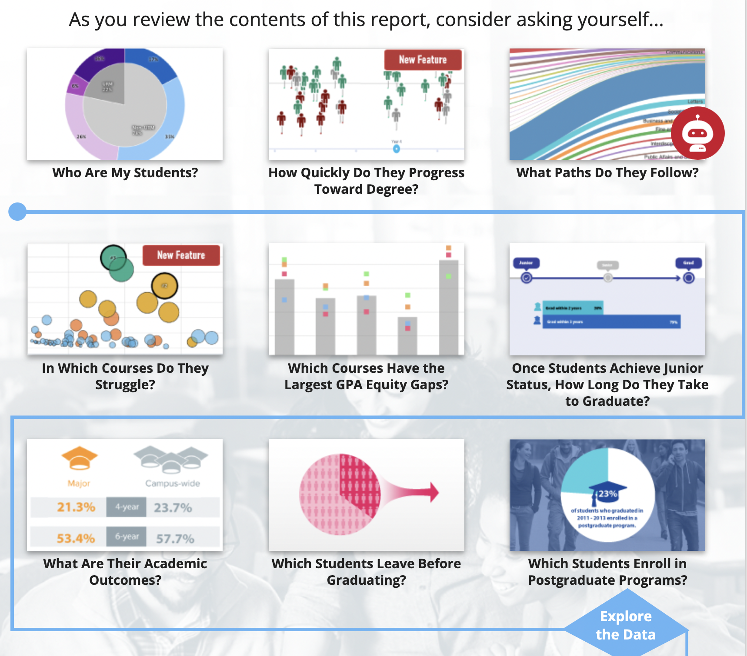
https://csusuccess.dashboards.calstate.edu/public/faculty-dashboard

Slide 8
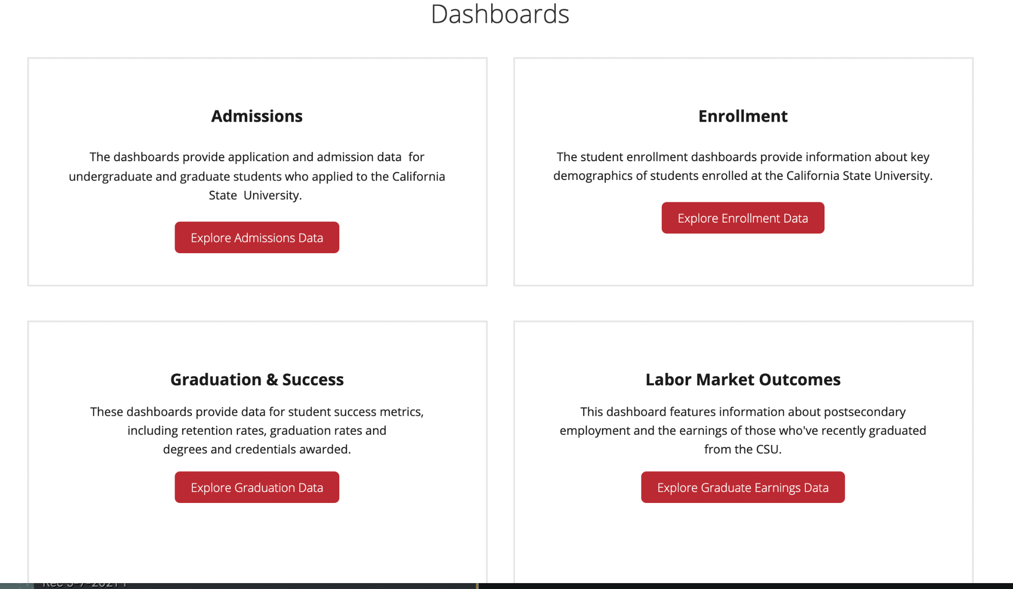
https://www2.calstate.edu/data-center/institutional-research-analyses/Pages/default.aspx

Slide 9
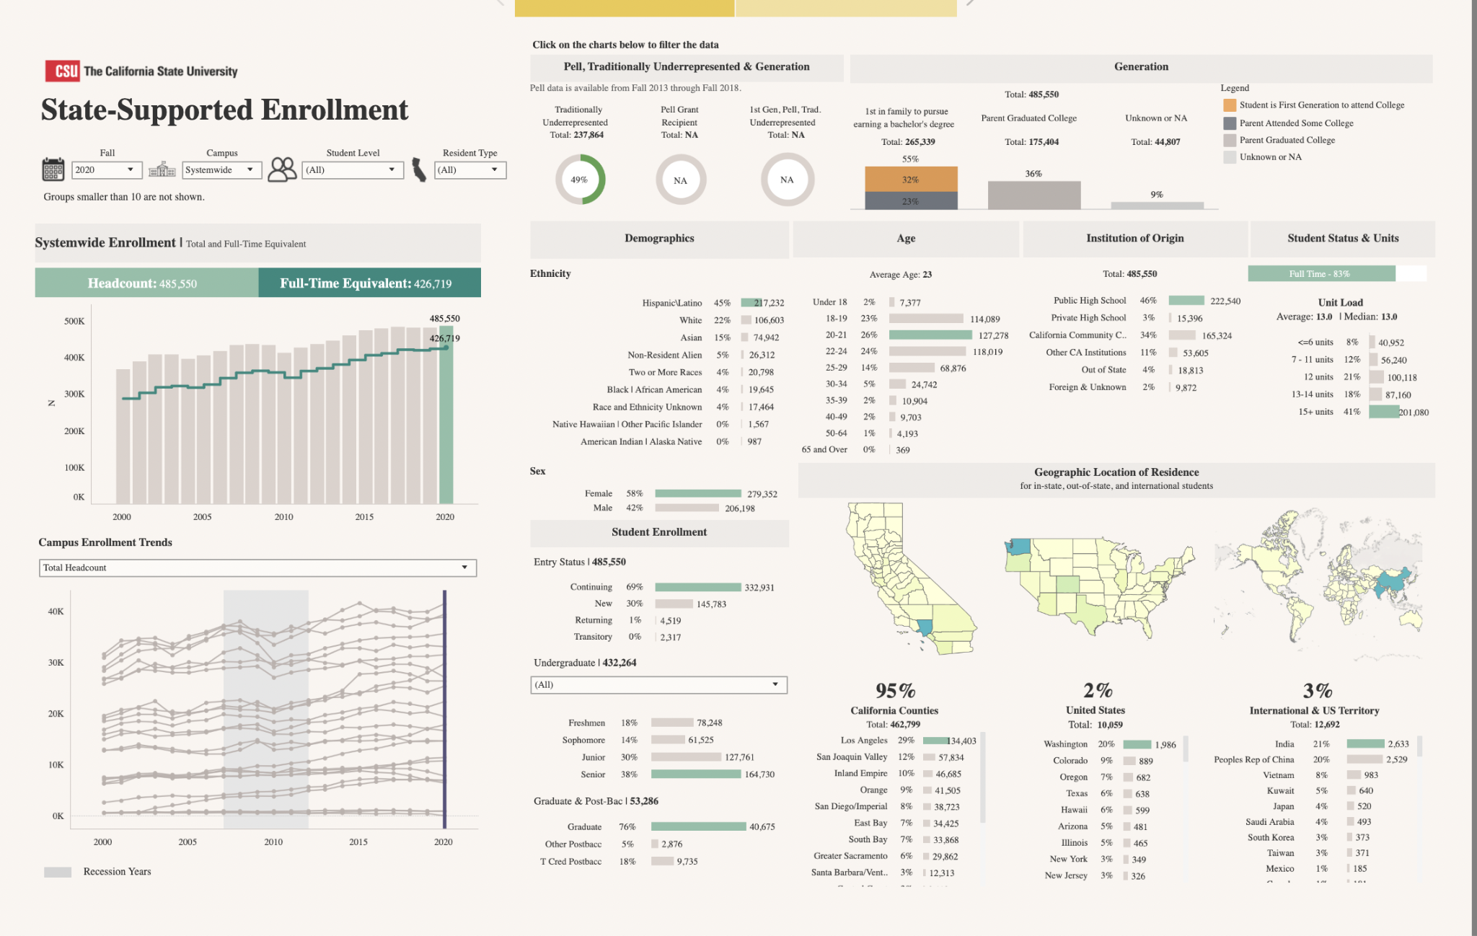
http://asd.calstate.edu/dashboard/enrollment-live.html

Slide 10
Start of Semester Survey
Goals
Course loads
…..

Slide 11
Midpoint Reflection

Slide 12
Learner Personas

Slide 13
Some key takeaways from Education Psychology literature about designing lessons

Slide 14



References
Notes:
Other references used in making these slides:
https://www.youtube.com/watch?v=IdMvWLARF1w
https://www.learning-theories.com/
RStudio Instructor Training

